Slide 1
Data Mining:
Concepts and Techniques
(3rd ed.)
— Chapter 6 —
Instructor: Dr. Ghulam Mustafa
University Institute of Information Technology
PMAS-Arid Agriculture University Rawalpindi
(slides courtesy Jiawei Han, Micheline Kamber, and Jian Pei

Slide 2
Chapter 6: Mining Frequent Patterns, Association and Correlations: Basic Concepts and Methods
Basic Concepts
Frequent Itemset Mining Methods
Which Patterns Are Interesting?—Pattern Evaluation Methods
Summary

Slide 3
What Is Frequent Pattern Analysis?
Frequent pattern: a pattern (a set of items, subsequences, substructures, etc.) that occurs frequently in a data set
Motivation: Finding inherent regularities in data
  What products were often purchased together?— Lotion and diapers?!
  What are the subsequent purchases after buying a PC?
Applications
  Basket data analysis, cross-marketing, sale campaign analysis, customer shopping behavior analysis..

Slide 4
Why Is Freq. Pattern Mining Important?
Freq. pattern: An intrinsic and important property of datasets
Foundation for many essential data mining tasks
  Association, correlation.
  Classification: discriminative, frequent pattern analysis
  Cluster analysis: frequent pattern-based clustering
  Data warehousing: iceberg cube and cube-gradient
  Broad applications

Slide 5
Basic Concepts: Frequent Patterns
Tid | Items bought
10 | Lotion, Nuts, Diaper
20 | Lotion, Coffee, Diaper
30 | Lotion, Diaper, Eggs
40 | Nuts, Eggs, Milk
50 | Nuts, Coffee, Diaper, Eggs, Milk
itemset: A set of one or more items
k-itemset X = {x₁, …, x_{k}}
(absolute) support, or, support count of X: Frequency or occurrence of an itemset X
(relative) support, s, is the fraction of transactions that contains X (i.e., the probability that a transaction contains X)
An itemset X is frequent if X’s support is no less than a minsup threshold
Customer
buys both
Customer
buys diaper
Customer
buys Lotion

Slide 6
Basic Concepts: Association Rules
Tid
Items bought
A→B (A implies B) represents the association rule that if X is purchased, then Y will also be purchased.
Find all the rules A → B with minimum support and confidence
  support, s, probability that a transaction contains A ∪ B
  confidence, c, conditional probability that a transaction having A also contains B
10
Lotion Nuts, Diaper
20
Lotion, Coffee, Diaper
30
Lotion, Diaper, Eggs
40
Lotion, Eggs, Milk
50
Nuts, Coffee, Diaper, Eggs, Milk
Customer
buys both
Customer
buys diaper
Customer
buys Lotion

Slide 7
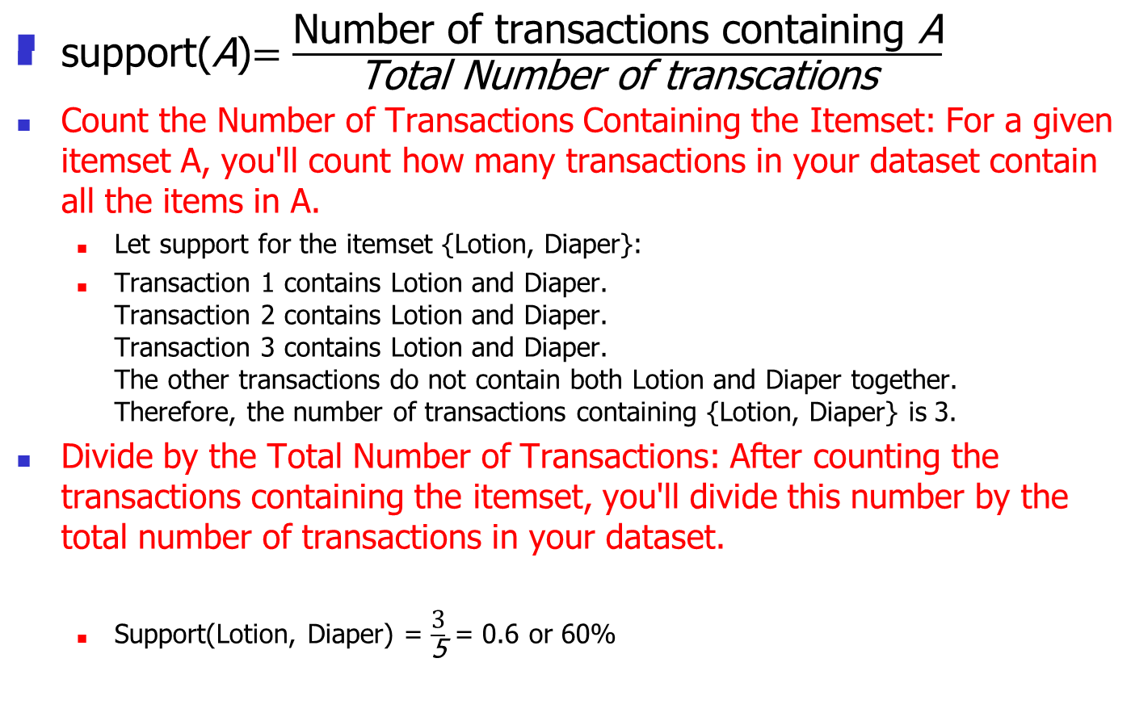
Support

Slide 8
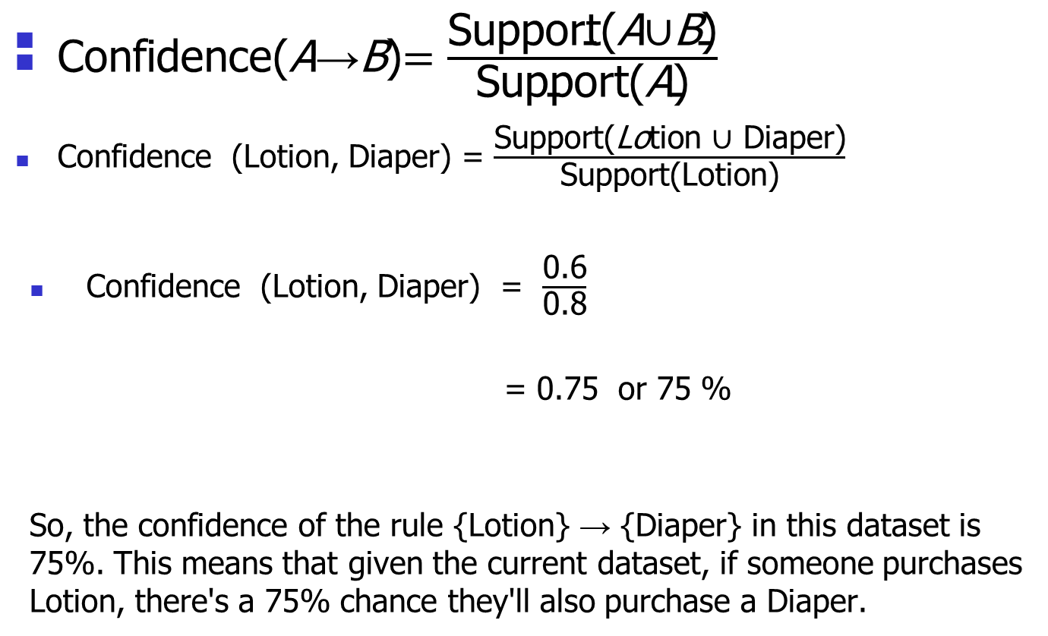
Confidence

Slide 9
Chapter 6: Mining Frequent Patterns, Association and Correlations: Basic Concepts and Methods
Basic Concepts
Frequent Itemset Mining Methods
Which Patterns Are Interesting?—Pattern Evaluation Methods
Summary

Slide 10
The Downward Closure Property and Scalable Mining Methods
The downward closure property of frequent patterns
  Any subset of a frequent itemset must be frequent
  If {Lotion, diaper, nuts} is frequent, so is {Lotion, diaper}
  i.e., every transaction having {Lotion, diaper, nuts} also contains {Lotion, diaper}
Scalable mining methods: Three major approaches
  Apriori (Agrawal & Srikant@VLDB’94)
  Freq. pattern growth (FPgrowth—Han, Pei & Yin @SIGMOD’00)
  Vertical data format approach (Charm—Zaki & Hsiao @SDM’02)

Slide 11
Apriori: A Candidate Generation & Test Approach
Apriori pruning principle: If there is any itemset which is infrequent, its superset should not be generated/tested! (Agrawal & Srikant @VLDB’94, Mannila, et al. @ KDD’ 94)
Method:
  Initially, scan DB once to get frequent 1-itemset
  Generate length (k+1) candidate itemsets from length k frequent itemsets
  Test the candidates against DB
  Terminate when no frequent or candidate set can be generated

Slide 12
The Apriori Algorithm—An Example
Sup_{min} = 2
Itemset | sup
{A} | 2
{B} | 3
{C} | 3
{D} | 1
{E} | 3
Database TDB
Itemset | sup
{A} | 2
{B} | 3
{C} | 3
{E} | 3
L₁
Tid | Items
10 | A, C, D
20 | B, C, E
30 | A, B, C, E
40 | B, E
C₁
1st scan
Itemset | sup
{A, C} | 2
{B, C} | 2
{B, E} | 3
{C, E} | 2
C₂
Itemset | sup
{A, B} | 1
{A, C} | 2
{A, E} | 1
{B, C} | 2
{B, E} | 3
{C, E} | 2
C₂
L₂
Itemset
{A, B}
{A, C}
{A, E}
{B, C}
{B, E}
{C, E}
2nd scan
Itemset
{A,B,C}
A,C,E
{B, C, E}
C₃
3rd scan
L₃
Itemset | sup
{B, C, E} | 2

Slide 13
The Apriori Algorithm (Pseudo-Code)
C_{k}: Candidate itemset of size k //Declaration of Ck: This variable stores the set of candidate itemsets of size 'k'.
L_{k} : frequent itemset of size k //Declaration of Lk: This variable stores the set of frequent itemsets of size 'k'.
L₁ = {frequent items}; // Initialize L1 with the list of items that are considered frequent based on a predefined threshold.
for (k = 1; L_{k} !=∅; k++) do begin // Start a loop from k=1 and keep increasing k until Lk (frequent itemset of size 'k') is empty
C_{k+1} = candidates generated from L_{k}; // Generate the candidates for the next iteration (of size k+1) from the frequent itemsets of size 'k'.
for each transaction t in database do
  increment the count of all candidates in C_{k+1} that are contained in t // Count how many times each candidate of size k+1 appears in the transaction.
L_{k+1} = candidates in C_{k+1} with min_support // Filter out the candidates that don't meet the minimum support threshold. Only the frequent ones are kept for the next iteration.
end
return ∪_{k} L_{k}; // Return the union of all Lk's, which represents all the frequent itemsets discovered in the database.

Slide 14
Implementation of Apriori
How to generate candidates?
  Step 1: self-joining L_{k}
  Step 2: pruning
Example of Candidate-generation
  L₃={abc, abd, acd, ace, bcd}
  Self-joining: L₃*L₃
    abcd from abc and abd
    acde from acd and ace
  Pruning:
    acde is removed because ade is not in L₃
  C₄ = {abcd}

Slide 15
How to Count Supports of Candidates?
Why counting supports of candidates a problem?
  The total number of candidates can be very huge
  One transaction may contain many candidates
Method:
  Candidate itemsets are stored in a hash-tree
  Leaf node of hash-tree contains a list of itemsets and counts
  Interior node contains a hash table
  Subset function: finds all the candidates contained in a transaction

Slide 16
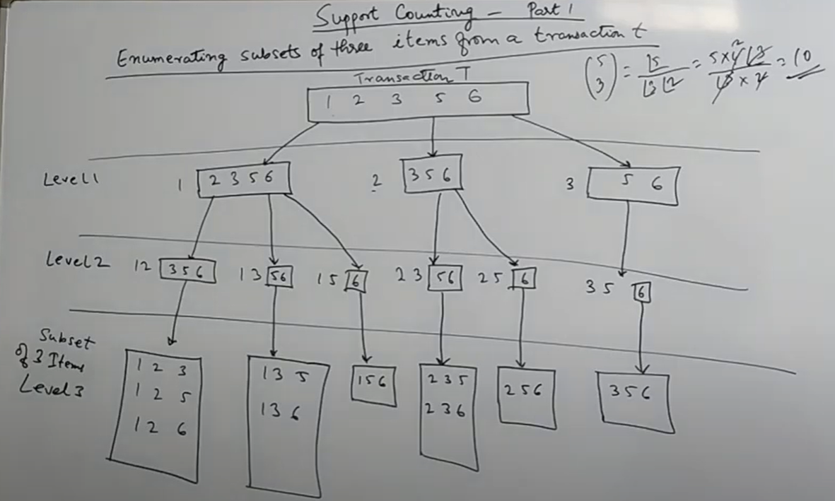
Counting Supports of Candidates Using Hash Tree

Slide 17
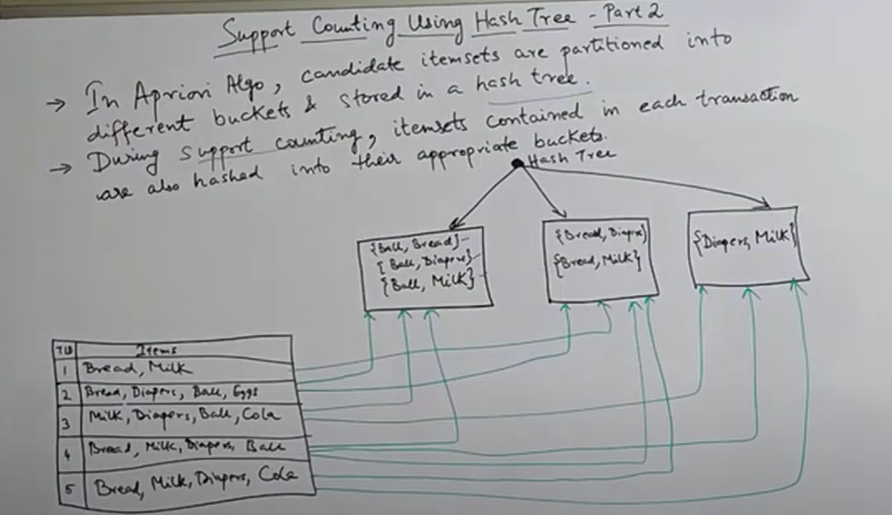
Counting Supports of Candidates Using Hash Tree

Slide 18
Generate Hash Tree
Suppose you have 15 candidate itemsets of length 3:
{1 4 5}, {1 2 4}, {4 5 7}, {1 2 5}, {4 5 8}, {1 5 9}, {1 3 6}, {2 3 4}, {5 6 7}, {3 4 5}, {3 5 6}, {3 5 7}, {6 8 9}, {3 6 7}, {3 6 8}
You need:
Hash function
Max leaf size: max number of itemsets stored in a leaf node (if number of candidate itemsets exceeds max leaf size, split the node)
An order on the items (e.g., 1 .. 9, Lotion, Bread, Coke, Diaper, Egg, Milk)
Hash function
hashed on the 1st item
3,6,9
2 3 4
5 6 7
1,4,7
hashed on the 2nd item
2,5,8
1 4 5
1 3 6
3 4 5
3 5 6
3 5 7
6 8 9
3 6 7
3 6 8
hashed on the 3rd item
1 2 4
4 5 7
1 2 5
4 5 8
1 5 9

Slide 19
Scalable Frequent Itemset Mining Methods
Apriori: A Candidate Generation-and-Test Approach
Improving the Efficiency of Apriori
FPGrowth: A Frequent Pattern-Growth Approach
ECLAT: Frequent Pattern Mining with Vertical Data Format
Mining Close Frequent Patterns and Maxpatterns

Slide 20
Further Improvement of the Apriori Method
Major computational challenges
  Multiple scans of transaction database
  Huge number of candidates
  Tedious workload of support counting for candidates
Improving Apriori: general ideas
  Reduce passes of transaction database scans
  Shrink number of candidates
  Facilitate support counting of candidates

Slide 21
Scalable Frequent Itemset Mining Methods
Apriori: A Candidate Generation-and-Test Approach
Improving the Efficiency of Apriori
FPGrowth: A Frequent Pattern-Growth Approach
ECLAT: Frequent Pattern Mining with Vertical Data Format
Mining Close Frequent Patterns and Maxpatterns

Slide 22
Pattern-Growth Approach: Mining Frequent Patterns Without Candidate Generation
Bottlenecks of the Apriori approach
  Breadth-first (i.e., level-wise) search
  Candidate generation and test
    Often generates a huge number of candidates
The FPGrowth Approach (J. Han, J. Pei, and Y. Yin, SIGMOD’ 00)
  Depth-first search
  Avoid explicit candidate generation
Major philosophy: Grow long patterns from short ones using local frequent items only
  “abc” is a frequent pattern
  Get all transactions having “abc”, i.e., project DB on abc: DB|abc
  “d” is a local frequent item in DB|abc → abcd is a frequent pattern

Slide 23
Construct FP-tree from a Transaction Database
TID Items bought
100 {f, a, c, d, g, i, m, p} {f, c, a, m, p}
200 {a, b, c, f, l, m, o} {f, c, a, b, m}
300 {b, f, h, j, o, w} {f, b}
400 {b, c, k, s, p} {c, b, p}
500 {a, f, c, e, l, p, m, n} {f, c, a, m, p}
min_support = 3
Item frequency
f 4
c 4
a 3
b 3
m 3
p 3
Scan DB once, find frequent 1-itemset (single item pattern)
Sort frequent items in frequency descending order, f-list
Scan DB again, construct FP-tree
F-list = f-c-a-b-m-p

Slide 24
Ordered Itemset
F-list = f-c-a-b-m-p
Cross check each of our transaction if that particular item set is present in
frequent itemset list. If yes then include in ordered itemset
TID Items bought (ordered) frequent items
100 {f, a, c, d, g, i, m, p} {f, c, a, m, p}
200 {a, b, c, f, l, m, o} {f, c, a, b, m}
300 {b, f, h, j, o, w} {f, b}
400 {b, c, k, s, p} {c, b, p}
500 {a, f, c, e, l, p, m, n} {f, c, a, m, p}

Slide 25
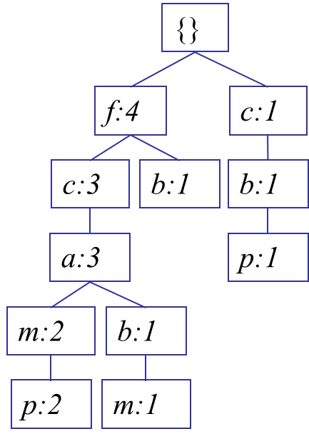
Trie Data Structure
All the ordered itemsets are inserted into Trie
data structure.
Root node would be present before any transaction
Now consider the first transaction and create node for each and every item along with frequency
TID Items bought (ordered) frequent items
100 {f, a, c, d, g, i, m, p} {f, c, a, m, p}
200 {a, b, c, f, l, m, o} {f, c, a, b, m}
300 {b, f, h, j, o, w} {f, b}
400 {b, c, k, s, p} {c, b, p}
500 {a, f, c, e, l, p, m, n} {f, c, a, m, p}
Root Node

Slide 26
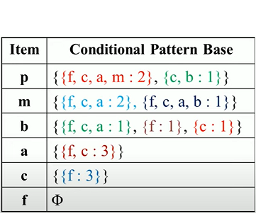
Conditional Pattern Base
Now we will create conditional pattern base
  The path labels of all the paths which lead to any node of the given item in frequent-pattern tree
  First path ()
{}
f:4
c:1
c:3
b:1
b:1
a:3
p:1
m:2
b:1
p:2
m:1

Slide 27
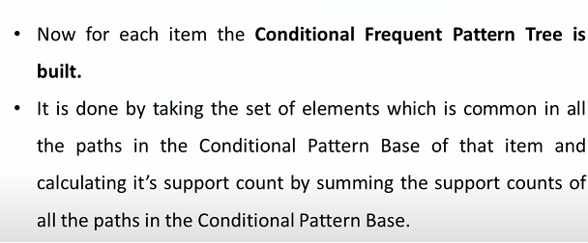
Conditional Frequent Pattern Tree

Slide 28
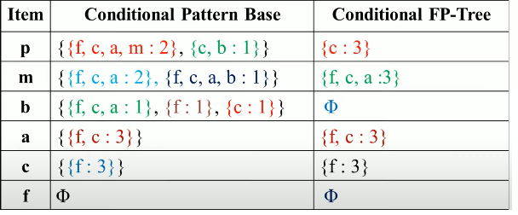
Conditional Frequent Pattern Tree

Slide 29
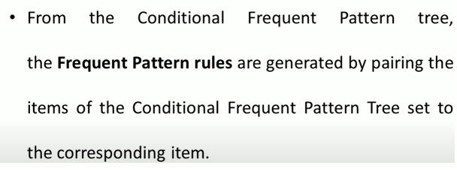
Frequent Pattern Rules

Slide 30
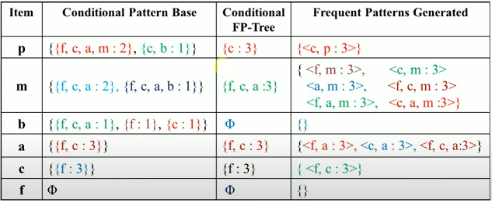
Frequent Pattern Rules
Pairing the item with conditional FP-Tree

Slide 31
Benefits of the FP-tree Structure
Completeness
  Preserve complete information for frequent pattern mining
  Never break a long pattern of any transaction
Compactness
  Reduce irrelevant info—infrequent items are gone
  Items in frequency descending order: the more frequently occurring, the more likely to be shared
  Never be larger than the original database (not count node-links and the count field)

Slide 32
The Frequent Pattern Growth Mining Method
Idea: Frequent pattern growth
  Recursively grow frequent patterns by pattern and database partition
Method
  For each frequent item, construct its conditional pattern-base, and then its conditional FP-tree
  Repeat the process on each newly created conditional FP-tree
  Until the resulting FP-tree is empty, or it contains only one path—single path will generate all the combinations of its sub-paths, each of which is a frequent pattern

Slide 33
Scaling FP-growth by Database Projection
What about if FP-tree cannot fit in memory?
  DB projection
First partition a database into a set of projected DBs
Then construct and mine FP-tree for each projected DB
Parallel projection vs. partition projection techniques
  Parallel projection
    Project the DB in parallel for each frequent item
    Parallel projection is space costly
    All the partitions can be processed in parallel
  Partition projection
    Partition the DB based on the ordered frequent items
    Passing the unprocessed parts to the subsequent partitions

Slide 34
Scalable Frequent Itemset Mining Methods
Apriori: A Candidate Generation-and-Test Approach
Improving the Efficiency of Apriori
FPGrowth: A Frequent Pattern-Growth Approach
ECLAT: Frequent Pattern Mining with Vertical Data Format
Mining Close Frequent Patterns and Maxpatterns

Slide 35
ECLAT
Frequent Pattern Mining with Vertical Data Format
ECLAT stands for Equivalence Class Clustering and Bottom-Up Lattice Traversal.
Popular method for association rule mining.
Lets have an example to see the working of ECLAT

Slide 36
ECLAT: Mining by Exploring Vertical Data Format
Tid | Bread | Butter | Milk | Coke | Jam
T1 | 1 | 1 | 0 | 0 | 1
T2 | 0 | 1 | 0 | 1 | 0
T3 | 0 | 1 | 1 | 0 | 0
T4 | 1 | 1 | 0 | 1 | 0
T5 | 1 | 0 | 1 | 0 | 0
T6 | 0 | 1 | 1 | 0 | 0
T7 | 1 | 0 | 1 | 0 | 0
T8 | 1 | 1 | 1 | 0 | 1
T9 | 1 | 1 | 1 | 0 | 0
It’s a Boolean matrix where for each cell (i , j) the value denotes whether the j^{th} is included in i^{th} transaction
1 means included while 0 mean not included
Minimum Support 2

Slide 37
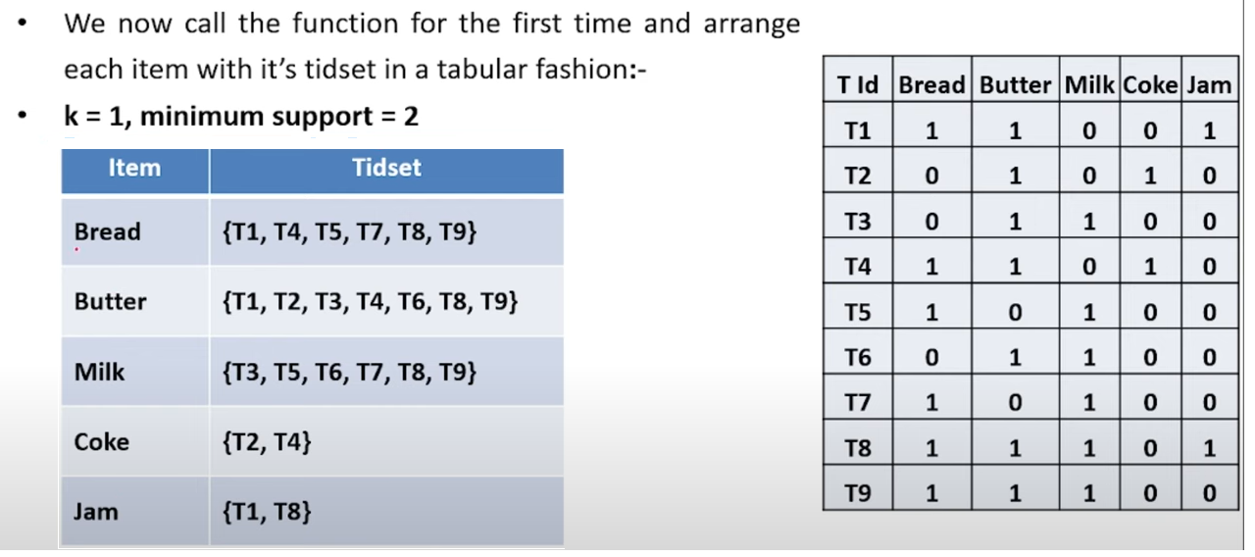
K= 1, Minimum Support =2
According to the support count all items are appearing in two or more sets

Slide 38
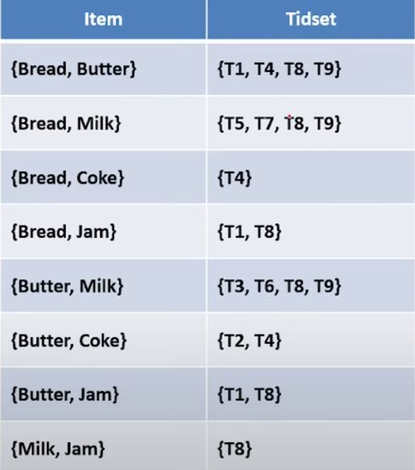
K= 2, Minimum Support =2
Will take the intersection of two.
    {Bread, Butter}, {Bread, Milk}, {Bread, Coke}, {Bread, Jam}, ………..
Now check Minimum support = 2
eliminate {bread, coke} and {Milk, jam})

Slide 39
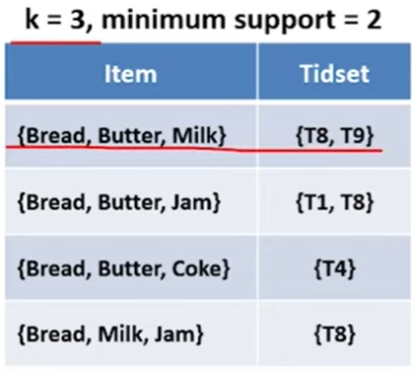
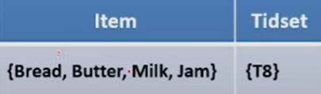
K= 3, 4 Minimum Support =2
K = 4
Infrequent

Slide 40

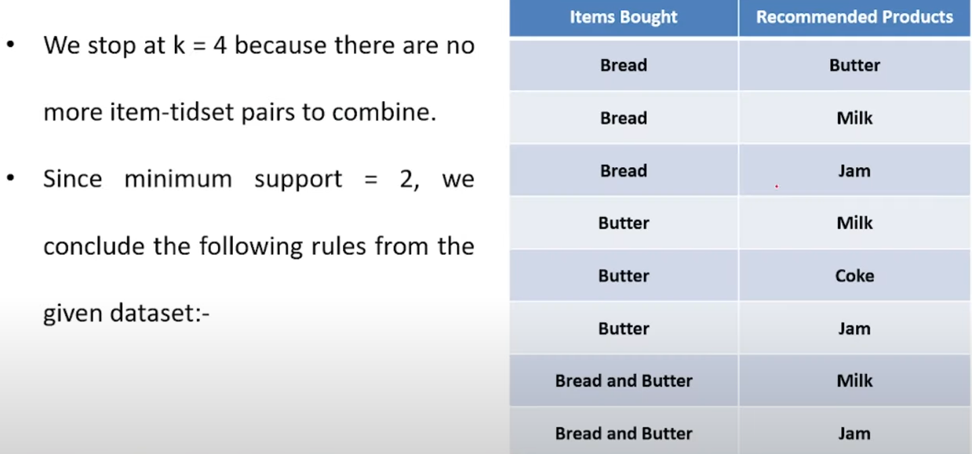
ECLAT Algo. Association Rule Mining

Slide 41
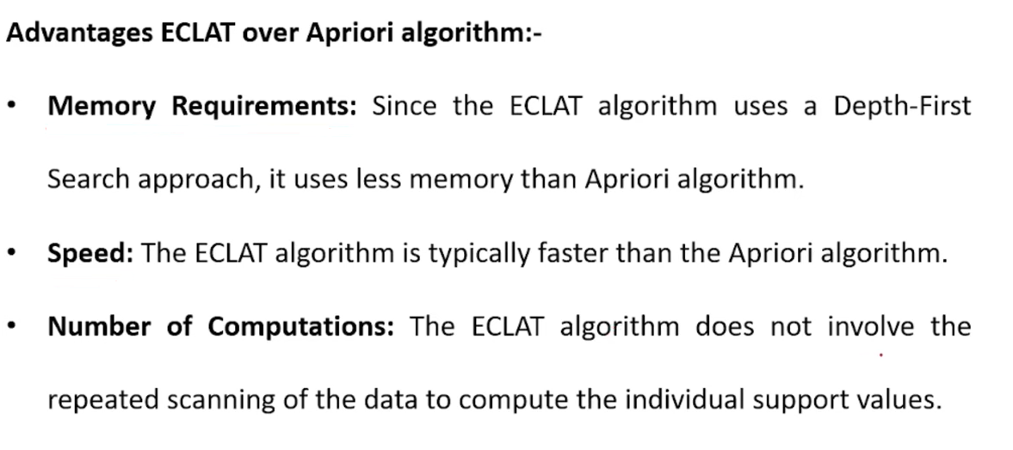
ECLAT Advantages

Slide 42
Summary
Basic concepts: association rules, support-confident framework, closed and max-patterns
Scalable frequent pattern mining methods
  Apriori (Candidate generation & test)
  Projection-based (FPgrowth, CLOSET+, ...)
  Vertical format approach (ECLAT, CHARM, ...)

Slide 43
Ref: Basic Concepts of Frequent Pattern Mining
(Association Rules) R. Agrawal, T. Imielinski, and A. Swami. Mining association rules between sets of items in large databases. SIGMOD'93
(Max-pattern) R. J. Bayardo. Efficiently mining long patterns from databases. SIGMOD'98
(Closed-pattern) N. Pasquier, Y. Bastide, R. Taouil, and L. Lakhal. Discovering frequent closed itemsets for association rules. ICDT'99
(Sequential pattern) R. Agrawal and R. Srikant. Mining sequential patterns. ICDE'95

Slide 44
Ref: Apriori and Its Improvements
R. Agrawal and R. Srikant. Fast algorithms for mining association rules. VLDB'94
H. Mannila, H. Toivonen, and A. I. Verkamo. Efficient algorithms for discovering association rules. KDD'94
A. Savasere, E. Omiecinski, and S. Navathe. An efficient algorithm for mining association rules in large databases. VLDB'95
J. S. Park, M. S. Chen, and P. S. Yu. An effective hash-based algorithm for mining association rules. SIGMOD'95
H. Toivonen. Sampling large databases for association rules. VLDB'96
S. Brin, R. Motwani, J. D. Ullman, and S. Tsur. Dynamic itemset counting and implication rules for market basket analysis. SIGMOD'97
S. Sarawagi, S. Thomas, and R. Agrawal. Integrating association rule mining with relational database systems: Alternatives and implications. SIGMOD'98

Slide 45
Ref: Depth-First, Projection-Based FP Mining
R. Agarwal, C. Aggarwal, and V. V. V. Prasad. A tree projection algorithm for generation of frequent itemsets. J. Parallel and Distributed Computing, 2002.
G. Grahne and J. Zhu, Efficiently Using Prefix-Trees in Mining Frequent Itemsets, Proc. FIMI'03
B. Goethals and M. Zaki. An introduction to workshop on frequent itemset mining implementations. Proc. ICDM’03 Int. Workshop on Frequent Itemset Mining Implementations (FIMI’03), Melbourne, FL, Nov. 2003
J. Han, J. Pei, and Y. Yin. Mining frequent patterns without candidate generation. SIGMOD’ 00
J. Liu, Y. Pan, K. Wang, and J. Han. Mining Frequent Item Sets by Opportunistic Projection. KDD'02
J. Han, J. Wang, Y. Lu, and P. Tzvetkov. Mining Top-K Frequent Closed Patterns without Minimum Support. ICDM'02
J. Wang, J. Han, and J. Pei. CLOSET+: Searching for the Best Strategies for Mining Frequent Closed Itemsets. KDD'03

Slide 46
Ref: Vertical Format and Row Enumeration Methods
M. J. Zaki, S. Parthasarathy, M. Ogihara, and W. Li. Parallel algorithm for discovery of association rules. DAMI:97.
M. J. Zaki and C. J. Hsiao. CHARM: An Efficient Algorithm for Closed Itemset Mining, SDM'02.
C. Bucila, J. Gehrke, D. Kifer, and W. White. DualMiner: A Dual-Pruning Algorithm for Itemsets with Constraints. KDD’02.
F. Pan, G. Cong, A. K. H. Tung, J. Yang, and M. Zaki , CARPENTER: Finding Closed Patterns in Long Biological Datasets. KDD'03.
H. Liu, J. Han, D. Xin, and Z. Shao, Mining Interesting Patterns from Very High Dimensional Data: A Top-Down Row Enumeration Approach, SDM'06.

Slide 47
Ref: Mining Correlations and Interesting Rules
S. Brin, R. Motwani, and C. Silverstein. Beyond market basket: Generalizing association rules to correlations. SIGMOD'97.
M. Klemettinen, H. Mannila, P. Ronkainen, H. Toivonen, and A. I. Verkamo. Finding interesting rules from large sets of discovered association rules. CIKM'94.
R. J. Hilderman and H. J. Hamilton. Knowledge Discovery and Measures of Interest. Kluwer Academic, 2001.
C. Silverstein, S. Brin, R. Motwani, and J. Ullman. Scalable techniques for mining causal structures. VLDB'98.
P.-N. Tan, V. Kumar, and J. Srivastava. Selecting the Right Interestingness Measure for Association Patterns. KDD'02.
E. Omiecinski. Alternative Interest Measures for Mining Associations. TKDE’03.
T. Wu, Y. Chen, and J. Han, “Re-Examination of Interestingness Measures in Pattern Mining: A Unified Framework", Data Mining and Knowledge Discovery, 21(3):371-397, 2010

